Slide 1
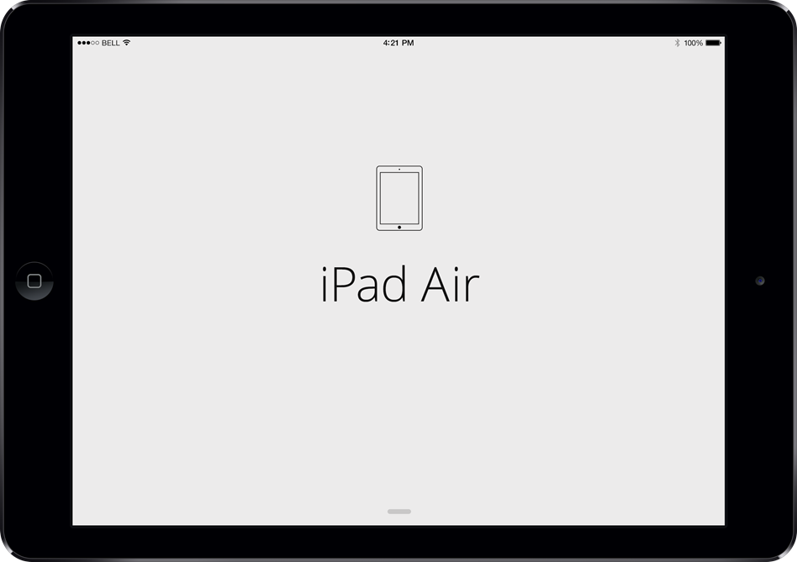

Mobile App Continuous Delivery
Wednesday,
Mobile App Continuous Delivery
Mobile App Continuous Delivery

Slide 2
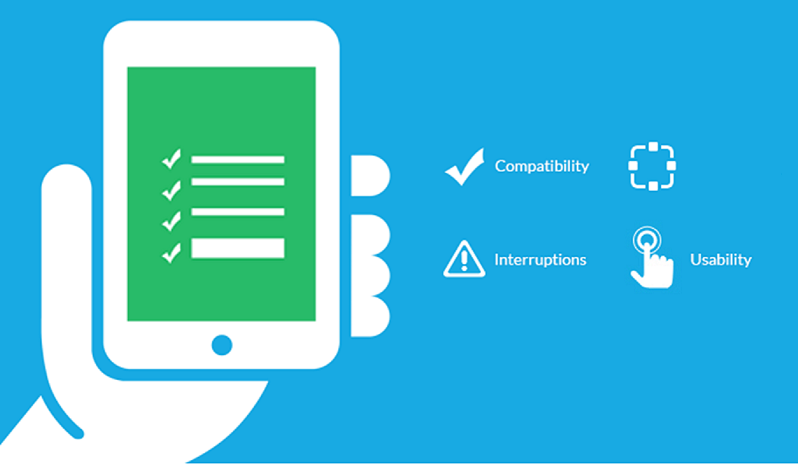
Why Mobile Testing different?
Operating Systems
Devices Models
OS Versions
App Versions
Device Availability
App Installation
Gestures (touch, pan)
User Experience
Device Lab Management

Slide 3






Why Continuous Delivery?
Develop
Build
Test
Develop Code
Unit Test
Merge Code
Push to Code Repo
Detect Push to Repo
Clean Workspace
Get Latest Code
Build Project
iOS
iOS Simulator
Device
Uninstall App
Reboot Device
Install App
Launch Test Agent
Develop Automated Script
Wakeup Device Pool
Execute Functional Test
Report Results

Slide 4
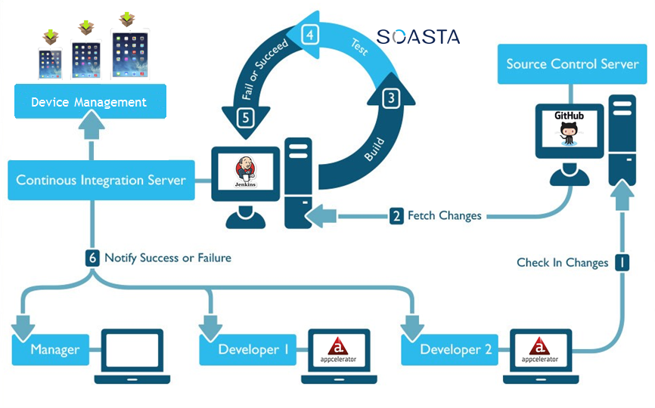

Continuous Delivery Model
Device Management

Slide 5

Claims System Overview

Slide 6
Challenges
Device Management

Slide 7
Alternatives
Device Management

Slide 8

Claims System Overview

Slide 9


